Slide 1
ST Dynamic Tag solution for LED
Duke Yang
STMicroelectronics MMY

Slide 2
RFID System
Hello, what s your name?
Energy + data =
RF-field
Signal modulation
Tag
RFID-reader
Load modulation
= chip + antenna
= RFID-reader chip + antenna
I am 007
Notes:
What is an RFID system ? An RFID system is composed of an initiator-the reader and the target-the tag itself.
The tag communicates to the reader by switching its load (from low to high and vice versa) and the reader can detect this change. This process is also known as load modulation.
On the other hand, the reader changes its carrier frequency via either amplitude or phase shift and the tag can decode this signal modulation. In addition, the reader also produces the RF-field that would power the tag.

Slide 3
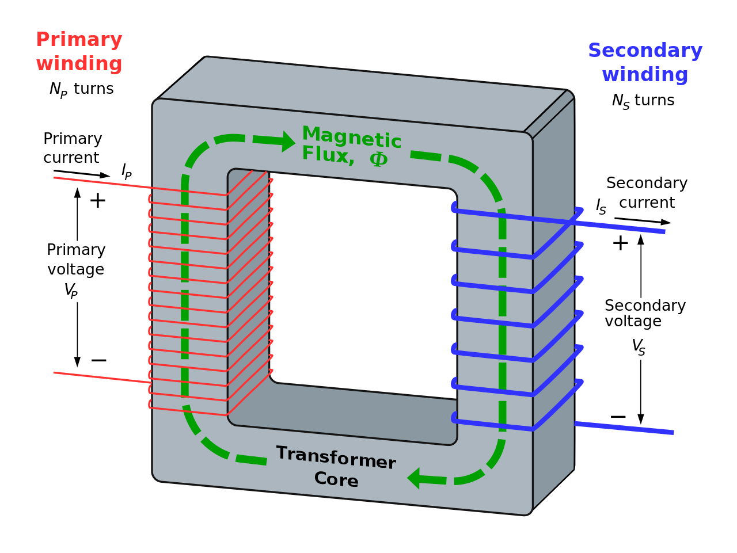
Ideal Transformer

Slide 4
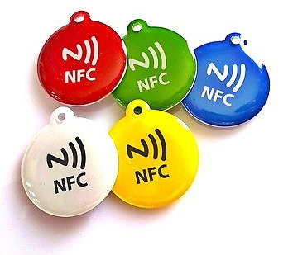
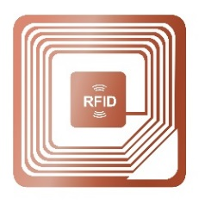

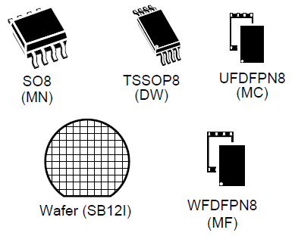
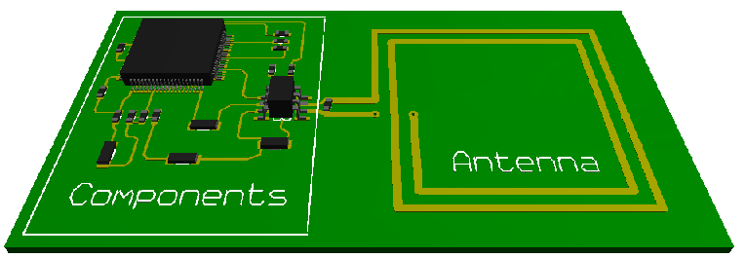
RFID Tag
Inlay
Notes:
An RFID tag can be created in various ways. A silicon die or package device is bonded or soldered to a copper or aluminum antenna.
The whole assembly rests on a non-conducting substrate like plastic, ceramic or printed circuit board material. We call this assembly an inlay.
As ST is a semiconductor manufacturer, we provide silicon die either in bared or packaged form. We have several partners that design and manufacture inlays.
As adhesive-backed inlays are simplest way to add RF identification to your product, you can also layout the antenna on your PCB and use packaged devices instead. Our ST25T and ST25D family comes in tiny DNF package.

Slide 5
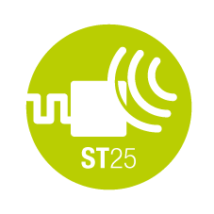
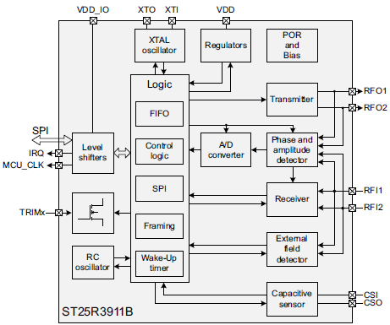

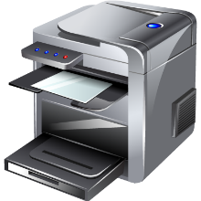
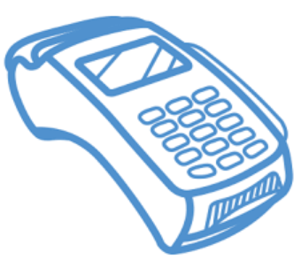
RFID/NFC Reader
RF
Transceiver
Bluetooth
STM32
MCU
Wi-Fi
ST31 Secure Element

Slide 6
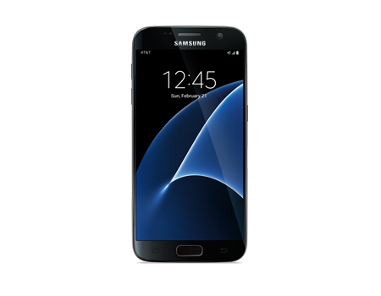
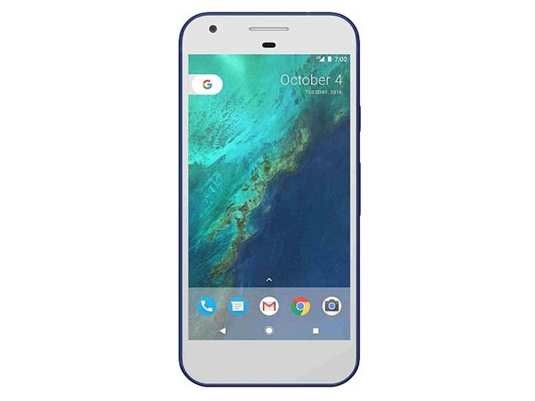
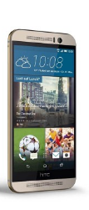
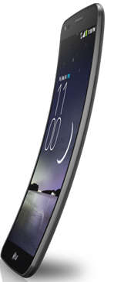
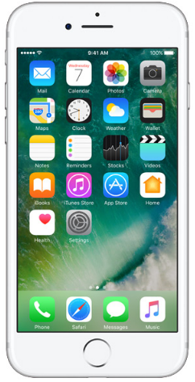
NFC-Enabled Smart Phones
The IOTs Magic Wands
2.2B NFC enabled phone by 2020!
Notes:
But we are already surrounded by NFC readers, billions of them.

Slide 7

NFC and RFID
NFC Forum
Type 2 and Type 4
NFC Forum
Type 5 *
NFC specification
→ Upper layer SW
ISO14443
Type A and Type B
« Short Range »
106kbps
ISO15693
« Long Range »
26kbps
ISO standards
HW/SW protocol
13.56 MHz
Notes:
NFC stands for Near Field Communication and the NFC standards were created by the NFC Forum-a collection of companies that manfufacturer products that use NFC chips or manufacturers of NFC chips such as ST Microelectronics.
The specifications cover all supporting protocols such as ISO14443A/B and ISO15693. Upon those protocols, NFC Forum create methods of data exchanges and the data formats themselves. This is where NDEF or NFC Data Exchange Format comes into play.

Slide 8
What is an NDEF Record?
Contain the User data.
The NFC forum defines the format of the NDEF record.
Different kinds of NDEF records :
  URL
  Text
  SMS
  Wi-Fi pairing
  Bluetooth pairing
  Smart poster….
Notes:
Within an NDEF message, one or more NDEF records can be found. Each NDEF record can contain URL or text. Some NDEF records can send text messages, dial a telephone number, and map out a geo location.
For example, if you use a phone with full NFC capability and tap it on an NFC tag that embeds the URL of your company, you will here a notification- your phone will automatically open the browser and take you to your company website.
Same convenience for Bluetooth and WIFI pairing, a simple touch will pair your devices or gain access to a internet router.

Slide 9
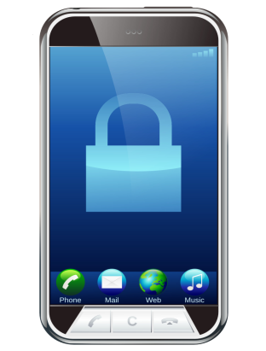


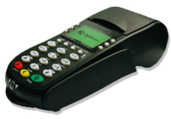
NFC Function
NFC device can act as
  TAG
  NFC reader/writer
NFC mode :
  Reader
  Card emulation
  Peer to Peer
Transceiver
Notes:
NFC devices can come in 3 different modes : reader, card emulation and peer to peer. Some NFC devices like a typical Android phone can offer all 3 modes
In reader mode, the NFC device reads or writes the memory of the tag.
In card emulation mode, the NFC devices like a smartphone mimics a tag. For example, the NFC transceiver inside the iPhone acts as a payment card which can be read using a POS terminal.
Sometimes, this mode is also known as tag emulation.
In Peer to Peer mode, 2 NFC devices can communicate to each other. They do it by taking turn being initiator and target.
Let s now see the difference on the read range between NFC and RFID.

Slide 10
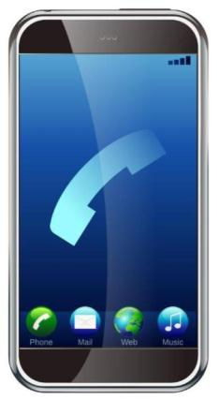
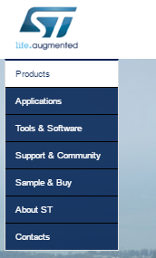
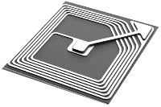



URL Link “Tap & Get Web Page”
« Tap & get web page »
Built-in technology
Native support with NFC phone
ST25 solutions: tag
Notes:
According to NFC Forum, executive messages such as loading a web pages, call a phone number, direct to a geo location or sending text messages can be embedded within an NFC tag.
You don’t have to turn on a QR code app. Just tap using the phone and you will be directed to the web site or run a web application.

Slide 11
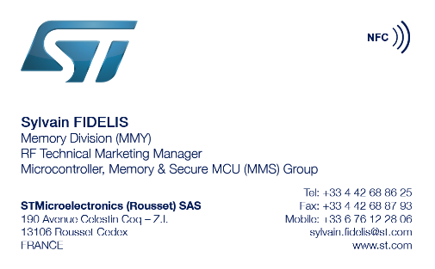

Business Card (vcard)
« Tap & download vcard »
Built-in technology
Native support with NFC phone
ST25 solutions: tag

Slide 12








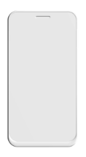
Identification
“Razor-Razor blade” model
Main unit
Reload
Reader IC
Tag IC
Main unit identifies reload with RFID
Buy refills using NFC

Slide 13

NFC for Access Control
Smart locks
Hotel access
Access control
ST25 solutions: NFC Readers
Notes:
.

Slide 14
Advent of NFC Dynamic Tag
NFC/RFID TAG
Wire interface
Dynamic tag
EEPROM
Wireless interface
Dynamic tag

Slide 15

Inside ST25DV
1.8V VOLTAGE REGULATOR
DIGITAL UNIT CONTROL
ENERGY HARVESTING CONTROL
FAST TRANSFER CONTROL
256 Bytes BUFFER
LPD
VDCG
ANALOG FRONT END
ENERGY HARVESTING
GPO
V_EH
MEMORY CONTROL
AC0
RF INTERFACE 28.5pF TUNING CAPACITOR
ISO/IEC 15693 PROTOCOL AND CONTROL
Vcc
I²C CONTROL
DYNAMIC REGISTERS
AC1
Vss
EEPROM
I²C INTERFACE
SDA
64K bits USER MEMORY
STATIC REGISTERS
SCL
*LPD, VDGC pin are only available with 12 pins (DFPN12) package version

Slide 16








Main ST25DV Market Segments
Smart Industry
Smart Home
Factory Automation, Industrial Lighting
Home Automation, Security Systems
Smart City
Smart Things
Metering, Street Lighting
Healthcare, Wellness
Notes:
The ST25DV open door for applications in Smart Industry, Smart Home, Smart City and Smart Things.

Slide 17
Manufacturing & Logistics Benefits
Flexibility
Customization
Control
Remote parameter programming
Regional settings
Use of activation keys
Display brightness
e-Pedigree of every meter produced
Last minute changes and updates
Options activation
Better control of Supply chain flow
Pre-personalization
Better management of complex product configurations

Slide 18
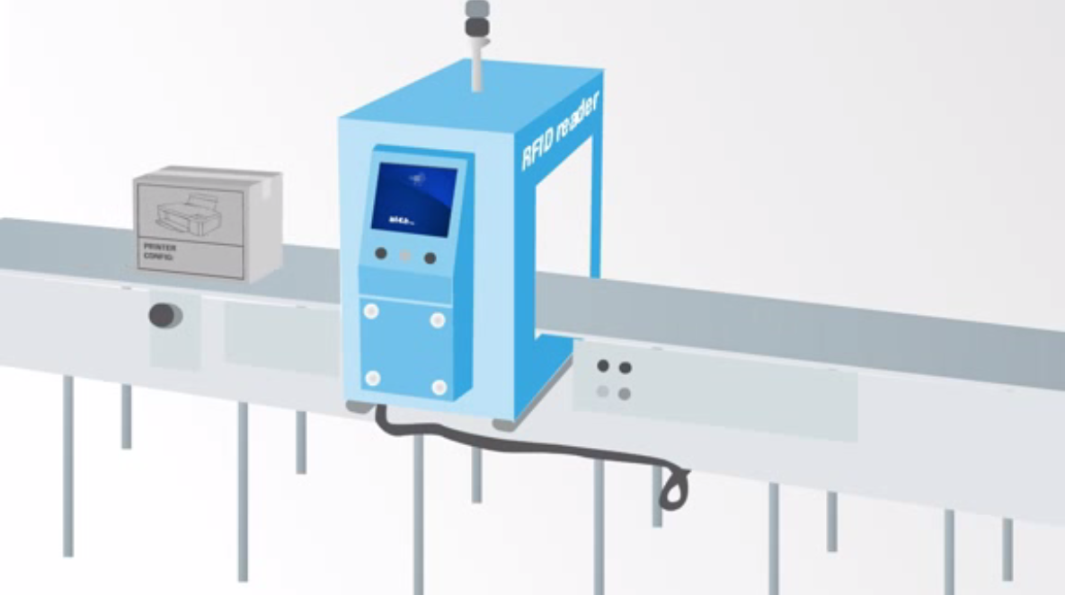

Slide 19
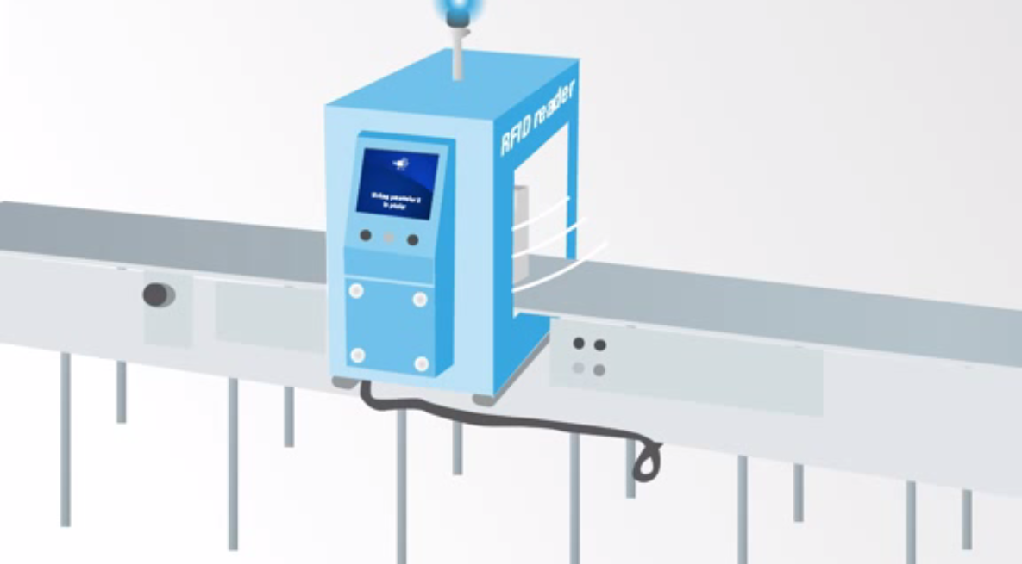

Slide 20
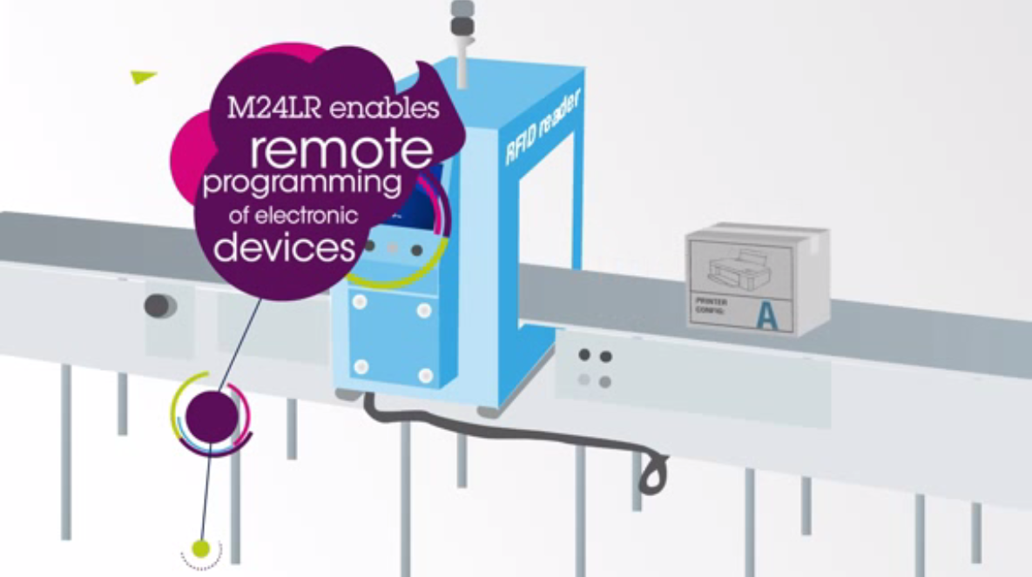
ST25

Slide 21


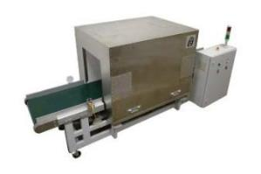
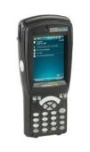
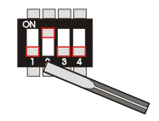
Device Programming in Production
Go contactless!
“DIP switch / resistor” type of setting
Contactless setting
0100
0100
  Device needs to be powered
  Programming device needs to be plugged in
  In-the-box programming
  Simple and flexible
ST25 solutions: tag with I2C
Notes:
As mentioned previously, RFID has huge implication in cost saving for manufacturing lines.
No more DIP switches and special resistors for setting the product to required state. All can be done wirelessly.

Slide 22
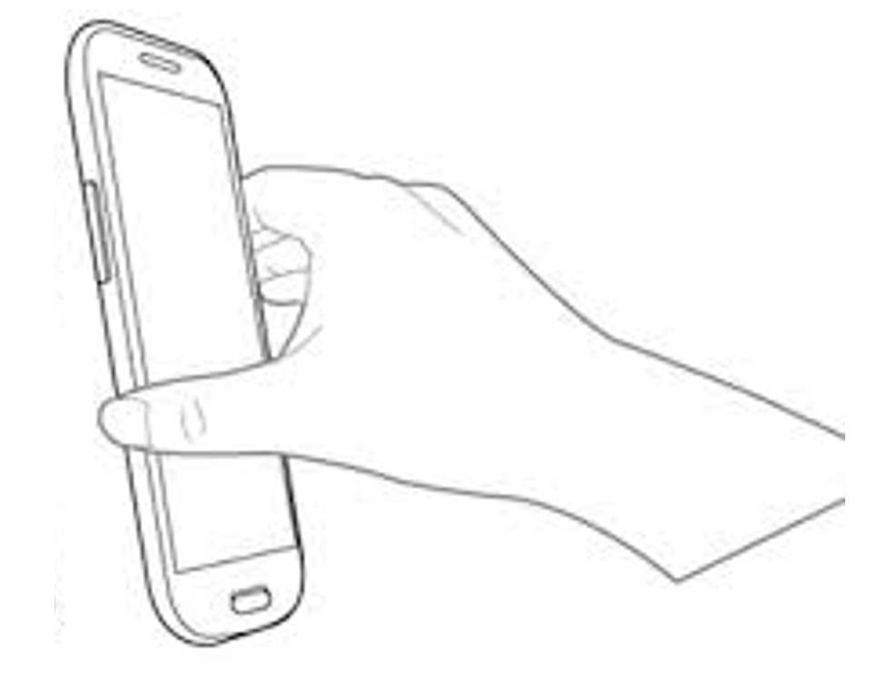
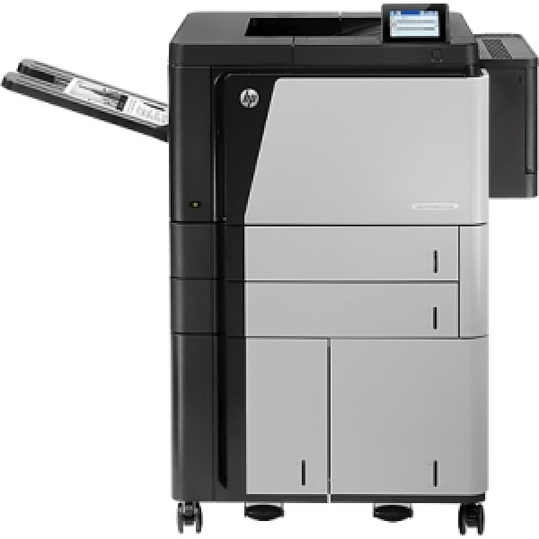
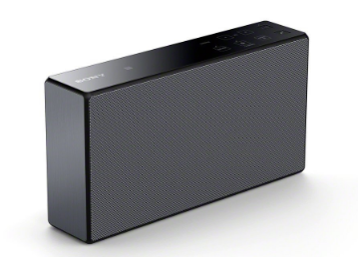
Wi-Fi and Bluetooth Pairing
Wi-Fi Direct
Avoid MITM (Man in the Middle) Attack.
One direction where a secret key TK (128-bit Randomizer) is read by the phone via NFC.
A Hash of the 128-bit Randomizer is also provide to ensure the integrity of the secret key.
Both TK and its hash can be created afresh at the end of every NFC pairing tap.
Notes:
Printers equipped with NFC allows phone or tablet to connect via WIFI direct by a simple tap This process is well specified by NFC Forum.

Slide 23


Cloud-Based Brand Protection
NFC Tag that stores certification of authenticity.
Purchasers confirm authenticity by using a phone app that connects to the manufacturer web application to confirm authenticity.
$2000 (Real)
$1000 (Fake)

Slide 24
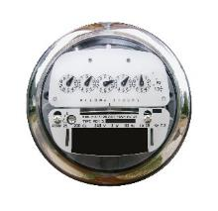

Device Commissioning Within
Meshed Wireless Networks
Program the relevant wireless
network ID and the node ID
during installation
ST25 solutions: tag with I2C
Notes:
With some 5.5 millions Internet-of-Thing devices connected everyday according to Gartner- a technology research firm, it is undoubtedly true that we need ways to connect them easily and efficiently…node by node.
Let me elaborate on this “commissioning” process. When a new peripheral node needs to be added to an existing network, it needs to communicate its MAC address and capability to the central node. NFC can perform the out-of-band hand-over and authentication. And since NFC is near-field, this exchange can be done securely.
This commissioning process can work with meshed network technology such as ZigBee or star topologies of LoRa WAN and Bluetooth Low Energy.

Slide 25
Device Commissioning Within
Star Wireless Networks
Peripheral Node
Central Node
Program the relevant wireless
network ID and the node ID
during installation
ST25 solutions: tag with I2C

Slide 26
What About Trusted and Secured
Onboarding Process
ST25DV
RF
Transceiver
ST BlueNRG
ST BlueNRG
STM32
MCU
STM32
MCU
LoRA
LoRA
ST31 Secure Element
ST31 Secure Element
Peripheral Node
Central Node
Notes:
In a cloud-based commissioning process, we only need the peripheral nodes to store a hardened certificate of authenticity. However, in a small private network not is not connected to the cloud, secured commissioning or onboarding requires

Slide 27

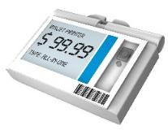

Battery-Less Designs…
Energy harvesting from NFC RF field
NFC connectivity
Up to 4mA
with NFC reader
ST one-stop-shop with low power MCU and sensors
ST25 solutions: tag with I2C and energy harvesting
Notes:
As semiconductor geometry shrinks, devices need less and less power to operated. These days, some chip only need few microamps to measure temperature, humidity and pressure. Coupled with power sipping microcontrollers like STM32L, you can build a sensor node that measures data every second with power footprint of few hundreds microamps.
If dynamic tag such as ST M24LR is used, it can deliver constant power of 900uA with antenna the size of a postage stamp as it is immersed in a magnetic field generated by a typical smart phone.
Let’s now have a look on the use cases for the reader.

Slide 28

NFC for Automotive
automotive
Access
Personal settings
Diagnose
ST25 solutions: NFC Readers
Notes:
Another use case for the reader is automotive for car access, it provides a Convenient access to the car and distribution of keys online to a NFC enabled phone.
Second one if personal settings, Just sit in, and the entire cockpit will fit the driver wish Your NFC phone will take care of secure pairing!
And then diagnostics as well, with No physical connection is anymore
required for car diagnostics, which helps on safety

Slide 29
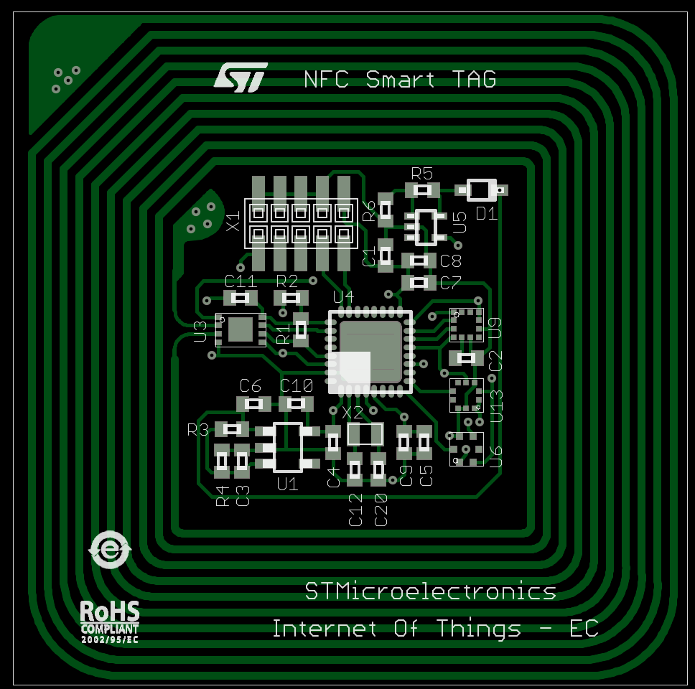

Connect Unconnected Things
HEY!!!
I can use
NFC sensor tag!
I think I watered it too much

Slide 30

Connect unconnected things!
Use NFC-enabled smart phone as a “magic wand”
Phone powers the sensor tags, collects data and relays it to the web application in the cloud.
Phone app tells the owner how to care for the bonsai based on the data.
No battery? No problem.

Slide 31
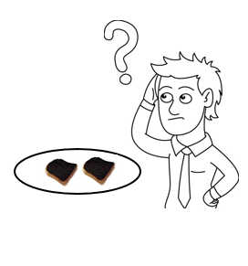

Firmware Update and So Much More!
My toaster oven keeps burning my toasts even if I set it to light. (firmware bugs)
I wish there is a mode for cooking pizza!
How can I tell the manufacturers my toaster oven faulty conditions?
Is this thing still in warranty?

Slide 32
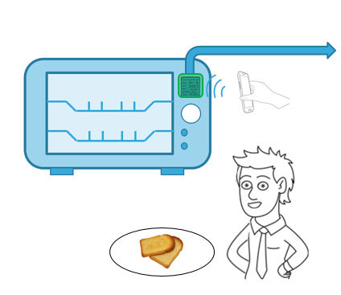
Putting NFC Dynamic Tags to Work
Add ST25DV and antenna behind LCD screen which is transparent to RF energy
Firmware download using Fast transfer mode. 50Kbytes in 20 seconds.
Store warranty information
Store operation data and fault conditions for diagnosis and repair

Slide 33
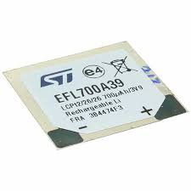
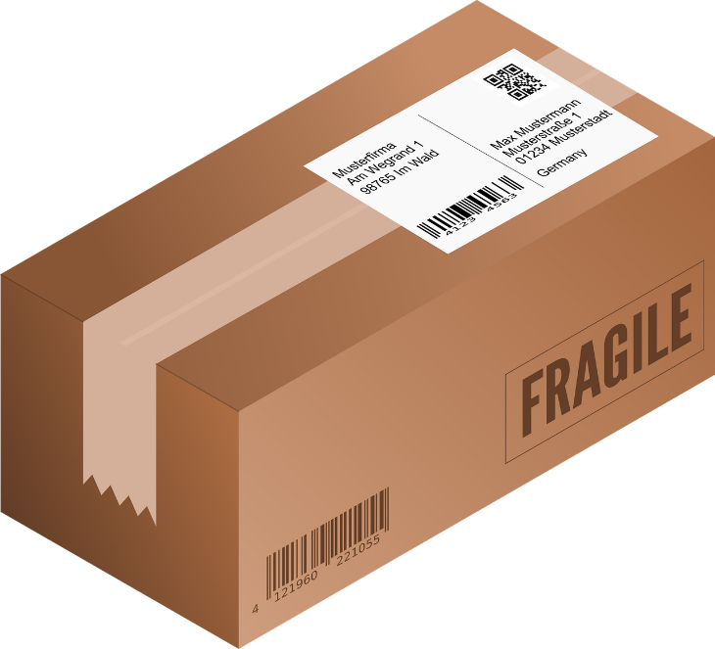
Smart Labels for Shipping
In battery mode, a smart label can register movements, shock, temperature, humidity for the duration of the shipment. NFC can also be used to wirelessly charge the label.

Slide 34

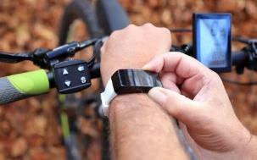



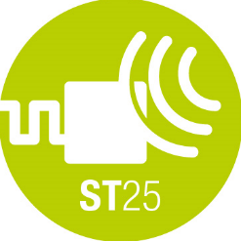





ST25 Matching ST Strategy
Wearable & Healthcare
Gaming & Payment
Connected Home
Home Appliance & Automation
Lighting & Metering
Asset tracking
Car access
Car center console

Slide 35






ST NFC Porfolio
Covering all NFC application needs and leveraging a rich ecosystem
www.st.com/nfc
NFC/RFID Tag
Dynamic NFC Tag
Secure NFC
NFC / RFID Reader
ST is a proud Sponsor Member
of the NFC Forum
NFC Controller

Slide 36






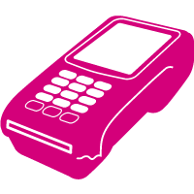


ST25 Products Families
www.st.com/st25t
Ticketing, Gaming, Medical, Brand protection, Access control, …
Tags
ST25T
13.56MHz
NFC phone / RFID Reader
Industrial, Consumer, Metering, Appliance, … (Fast Transfer Mode and SW upgrade)
www.st.com/st25d
Dynamic tags
STM32
microcontroller
ST25D
I2C
13.56MHz
NFC phone / RFID Reader
POS & mPOS Terminals, Automotive, Access control, …
www.st.com/st25r
Readers
STM32
microcontroller
ST25R
or
or
SPI
13.56MHz
NFC phone

Slide 37







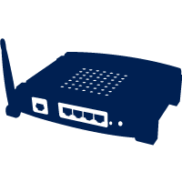




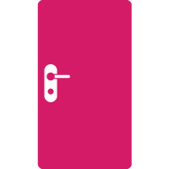

ST25 Series Enriching Our Lives!
Consumer
Home Appliance
Healthcare
Gaming
Brand recognition
Accessory
Asset
Tracking
Transport
Main Applications
Industrial
Smart Home Smart City
Access control
Automotive
Point
of sales

Slide 38





Certification & Interoperability Status
Tags
Dynamic tags
ST25TV
ST25TA
ST25TB
ST25DV
M24LR
M24SR
Not for NFC applications (RFID, ticketing)
Legacy product, not focusing on NFC applications
All parameters OK except chaining during write operations (**)
NFC Forum
Android
Not for NFC applications (RFID, ticketing)
iOS
Not for NFC applications (RFID, ticketing)
(*)
  (*) M24LR: 04E interoperable with iOS11 - 16E and 64E not iOS. ST25DV16K or ST25DV64K as replacement product for iOS interoperability
  (**) Chaining during write operations is not used by Smartphones

Slide 39







ST25DV Dynamic NFC Tag
ST25DV04K / 16K / 64K
Use cases
  Fast data exchange with NFC phones / HF readers. Long range
    Fast data transfer for MCU FW upgrade, Fast data exchange
    Parameters settings and update, with in the box programming
    Datalog download
  Battery less applications
Key Features
  ISO15693 and NFC Type V
  Fast data transfer thanks to 256 Bytes buffer
  Low Power mode, < 1µA power consumption in Standby
  -40 to +125°C (I2C) industrial Grade 8 temperature range
  Energy harvesting function through RF
Key Benefits
  Smart applications using a flexible interrupt GPO
  Enhanced protection with multiple 64-bit passwords
  Same 28.5pF internal RF tuning capacitor, as in M24LR
ISO
15693
NFC
Type V
26kb/s (53kb/s)
Buffer
I²C
1.8/5.5V
1MHz
RF Tag
BUFFER
256 Bytes
EEPROM
4K / 16K / 64K-bit
01001101110000
00110101001110
64-bit password
Digital output (GPO)
Energy harvesting
SO8
FPN8
FPN12
TSSOP8
WLCSP10
SBN12

Slide 40
ST25DV-W Dynamic NFC Tag
ST25DV02K-W1 / -W2
Use cases
  Industrial applications like Lighting LED driver, Motor control
Key Features
  ISO15693 and NFC Type V
  2K-bit memory
  Up to 2 PWM signal (push pull)
  Up to 15 bits resolution (62.5ns resolution step)
  Power Supply 1.8V - 5.5V
  -40 to +105°C (PWM) temperature range
  256-bit TruST25 Digital Signature
Key Benefits
  2 in 1 chip, putting NFC connectivity with PWM functionality
  Cost optimized solution to address low end Lighting market
    Significant BOM reduction as no MCU is required to drive the system
RF Tag
ISO
15693
NFC
Type V
26kb/s (53kb/s)
RF Tag
EEPROM
2K-bit
01001101110000
00110101001110
10110001101110
64-bit “encrypted” password
TruST25
256-bit signature
PWM output
SO8
TSSOP8

Slide 41
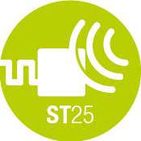
Key Use Cases

Slide 42
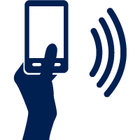
URL Link “Tap & Get Web Page”
Direct access to a Web page
Native support with NFC phone (NDEF)
Open a web page
ST solutions
Built-in technology
Tag

Slide 43


URL Link “Tap & Get Web Page”
Direct access to the Google Play store to download an app
Native support with NFC phone (NDEF)
Link to
ST solutions
Built-in technology
Tag
Dynamic Tag

Slide 44

E-warranty Card & Customer Registration
Pre-program activation email in ST25 product
Native support with NFC phone (NDEF)
Activate
Warranty
To: customer.service@st.com
Subject: warranty activation #627123A58-A
Dear customer service,
I would like to activate the warranty card for item serial number #627123A58-A and apply for the 2-year program.
ST solutions
Built-in technology
Tag
Dynamic Tag

Slide 45

Business Card (Vcard)
Tap & download the contact on your phone
Native support with NFC phone (NDEF)
New
Contact
ST solutions
Built-in technology
Tag

Slide 46







Tap & Identify
Track & Trace, Consumer Engagement and Cloud-based brand protection
Branding and consumer engagement
Product identification with enriched information
Identity check using digital signature
Anti counterfeiting with Tamper detect
ST solutions
Tag

Slide 47
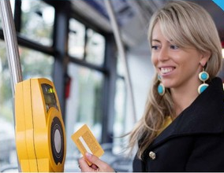

Transport
Contactless electronic ticketing
  Fast data transfer
  (ISO14443-B)
  Large and unique counting capability
  with anti-tearing feature
  Anti-collision mechanism
  compatible with most popular contactless ticketing systems
ST solutions
Tag
HF Reader

Slide 48

Asset Tracking
Enhanced logistic operations
Add relevant information onto your NFC / RFID tag
Information will be protected by passwords
Up to date information
Up-date the electronic label whenever necessary
Combined benefits of RFID & NFC technologies
ST solutions
Tag
HF Reader

Slide 49


Wireless Pairing “Tap & Connect”
Easily pair your connected devices
Native support with NFC phone (NDEF)
Ease Bluetooth / Wifi pairing by simple tap
Just wave your phone to pair
Plug & play technology
Built-in handover in Android & Windows
Multi-user management
Tap your phone to give or take control
Zero impact on power budget
zero power interface & and features field detect
ST solutions
Built-in technology
Tag
Dynamic Tag

Slide 50
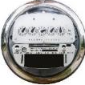
Commissioning
Simplify commissioning process at installation with a simple Tap
Node identification with enriched information
Tap & Program the relevant network ID and node ID
Protocol independent – one step commissioning
Parameter setting to enable specific functionality
ST solutions
Dynamic Tag

Slide 51

Parameter Setting
Save time on your production lines
From DIP switch / resistor to contactless setting
Get rid of manual operation
In the Box “programming”
Simple & flexible
Upload new setting to powered off devices
Personalize your boxed devices on the production belt
ST solutions
Dynamic Tag

Slide 52

Maintenance & Service
Real-time communication and in application programming
Fast Transfer Mode with 256 Byte buffer
for data synchronization and Firmware update
Manage your stock efficiently
With easy reconfiguration of boxed products
Convenient access to the embedded device
For diagnostic and re-programming
ST solutions
Dynamic Tag

Slide 53
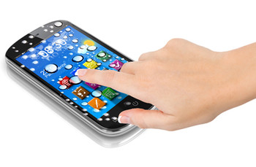

Tap & Display
Seamless user interface simplicity
Provide any electronic device with remote display
Use your NFC-enabled Smartphone or Tablet
Several native operation options
Enhanced with a suited App
Let any object become Smart with a Tap
Exploit Smartphone processing power
ST solutions
Dynamic Tag

Slide 54





Tap & Power
Energy Harvesting to power low power devices
Energy harvesting from NFC RF Field
NFC connectivity
Enhanced with a suited App
Power
system
&
Communicate
Up to 5mA with NFC reader
ST one-stop-shop with low power MCU and sensors
SmarTAG solution
ST solutions
Dynamic Tag

Slide 55
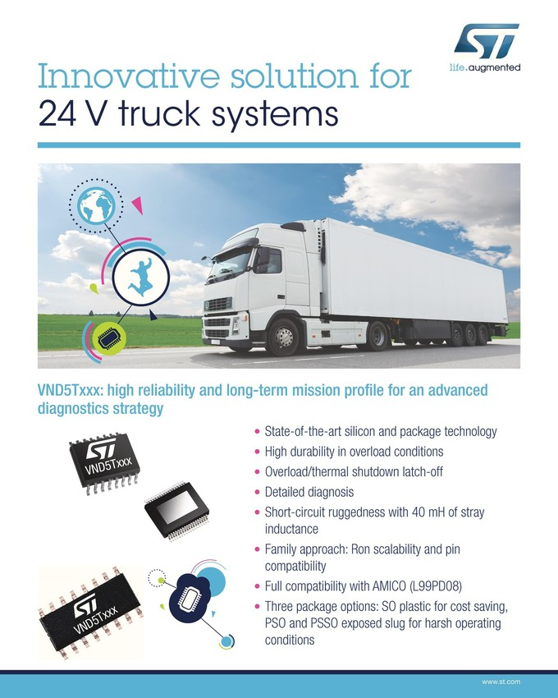

Convenient Data-logging
Data-log on the spot or off-line data access for consumer & industrial applications
Convenient access to your monitored data
Easy to do with a smartphone as display
Broad range of application
Logistics, Maintenance assistance, Consumer
Data accessible even when system is powered off
Tag acting as a “black box” tool
ST solutions
Dynamic Tag
HF Reader

Slide 56


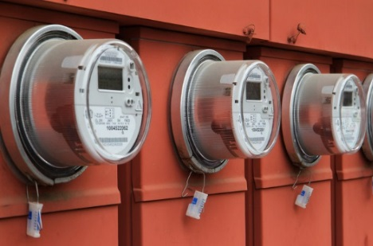
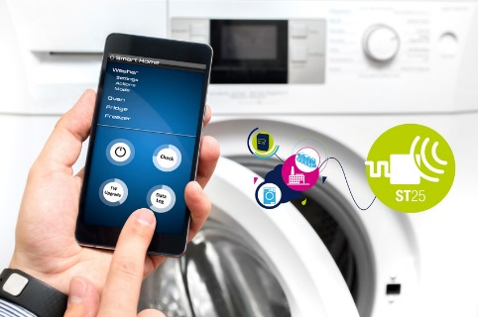





Dynamic Tag enabling multiple Benefits
During the Entire Product Lifecycle
Parameter setting in production
Logistics / Asset tracking
Commissioning / Pairing
Remote programming
Data download / data-log
Servicing & maintenance

Slide 57

Payment
Payment made easy and secure
Payments & Home Banking
Full EMVco POS and mobile POS (mPOS)
for cashless transactions with minimal investment
Enhanced user experience
Collect and process more data
Add new services
ST solutions
HF Reader

Slide 58

Automotive
Car access and console personalization
NFC for keyless car access
Convenient and secure access to the car
Distribution of keys online to your NFC smartphone
In-car personalization with secure pairing
Just sit in, and the entire cockpit will fit the driver wish
NFC for car diagnostic
No physical connection needed – safety is improved
ST solutions
HF Reader

Slide 59

Connected Homes
Second screen & remote UI
Use your NFC smartphone to Tap & configure,
while authentication feature let you safely access
your online accounts, gaming, or social media
Quick and secure pairing to any connected device Tapping a TV will turn your Phone into a second screen
ST solutions
Dynamic Tag
HF Reader

Slide 60

Entertainment & Gaming
Enhance your gaming possibilities by using NFC
NFC figurines come to life,
by using NFC to connect to a gaming console
With NFC Player and figurine
can interact without any external battery need
ST solutions
Tag
HF Reader

Slide 61

NFC Infrastructure
Access control made smart
Smart locks
NFC assisted lock configuration to grant
temporary access rights (maintenance, friends,…)
Hotel Access
Easy room access with cards or NFC smartphones
ST solutions
Tag
HF Reader

Slide 62




Accessory recognition (1/2)
Brand recognition and parameters setting
NFC for accessory identification
Convenient and reliable brand identification
Automatic System configuration
Upon accessory type recognition
Brand Recognition
Ensure only branded accessory are used
ST solutions
Tag
Dynamic Tag
HF Reader

Slide 63


UHF reader for Logistics
Ideal for battery operated handheld devices
UHF solution
Suitable for Hand-held readers, stationary readers,
Embedded readers and mobile UHF RFID readers
Dense Reader Mode
for Battery Handheld
Fast Moving Consumer Goods
ST solutions
UHF Reader

Slide 64
Thank You!

